Slide 1
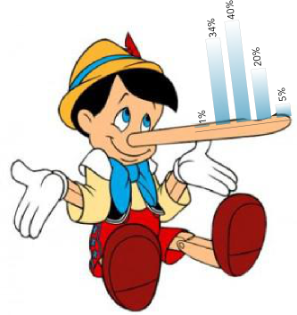

@mrogati
Notes:
Lies, Damned Lies and the Data Scientist
By: Monica Rogati – data scientist at LinkedIn.
Data lies – but it lies because we let it. So let’s not let it. Ask the right questions.

Slide 2


hottest industries
The Mission:
Notes:
What’s the definition of Hot?

Slide 3



+
date
joined
LinkedIn
The data

Slide 4
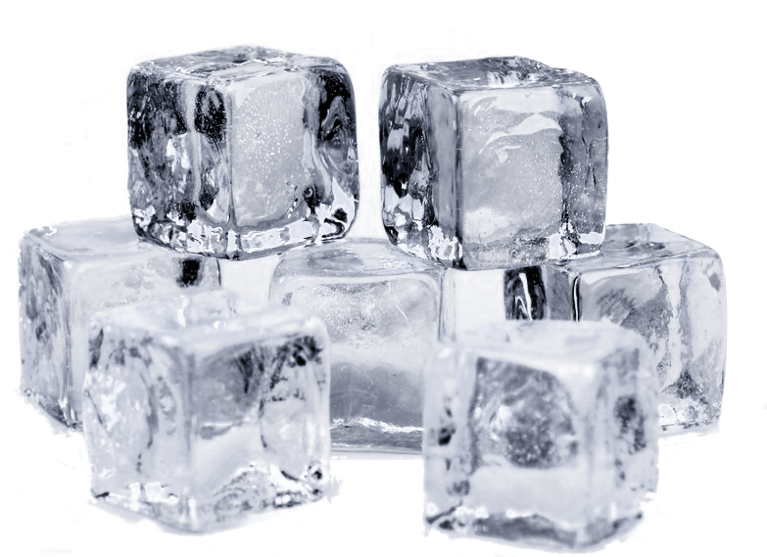
hottest industries
Hotness (X) =
Year-over-year growth of
people in industry X
on LinkedIn
The Question
Notes:
Terrible idea!

Slide 5




The data

Slide 6
hottest industries
Hotness (X) =
Year-over-year growth of
people job starters
in industry X
on LinkedIn
The Question

Slide 7
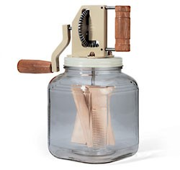

Externa-lies
Notes:
You run the numbers… Wait a second!! Is consulting really the hottest industry? Hmm..

Slide 8

Externa-lies
Notes:
Seasonality!
Also, some people don’t mention the month.

Slide 9

Externa-lies
Notes:
Are the Mining and metals & Dairy industries really the hottest industries?

Slide 10
hottest industries
Hotness (X) =
part year-over-part year growth of
net job starters
in a big enough industry X
on LinkedIn
The Question

Slide 11
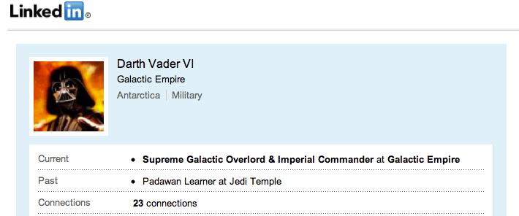

Dirty data, dirty lies

Slide 12
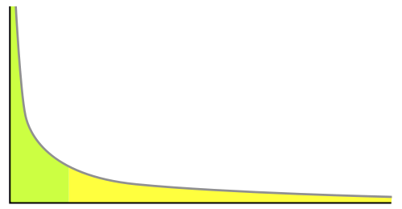
# profiles
# jobs on LinkedIn profile *
Dirty data, dirty lies
* hypothetical data

Slide 13
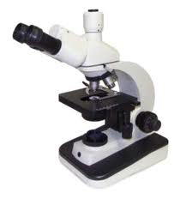
Check
flags,
categories,
dates,
…
Dirty data, dirty lies

Slide 14
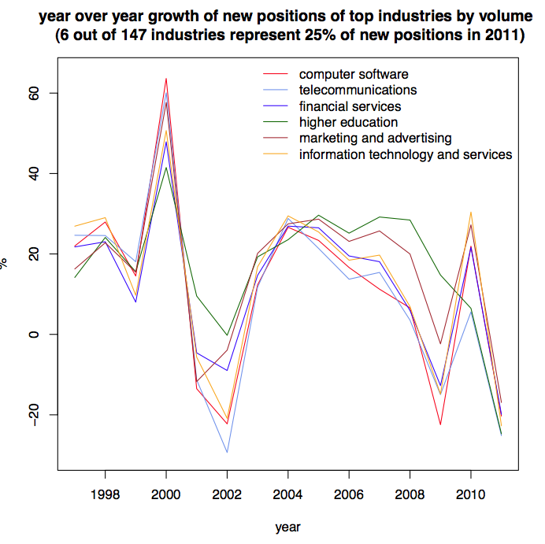
Norma-lies
Notes:
Account for website growth.
Normalize by # of people who started jobs that year

Slide 15
hottest industries
Hotness (X) =
part year-over-part year growth of
normalized net job starters,
minus noise,
in a big enough industry X
on LinkedIn
The Question

Slide 16
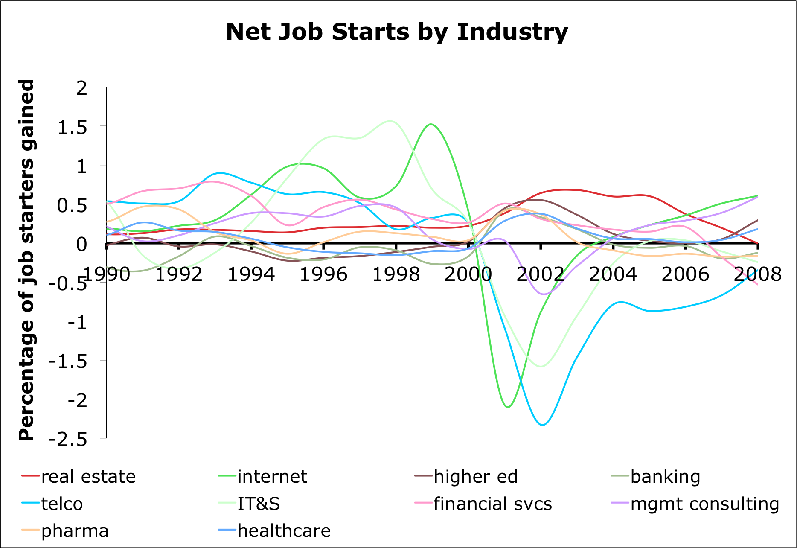
Norma-lies

Slide 17
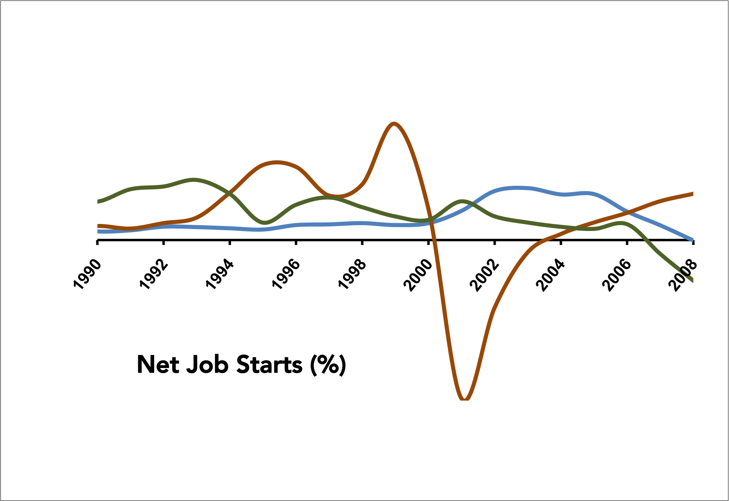
Internet
Real Estate
Financial Services
Truth by omission
Notes:
Tell the story: pick out what’s interesting

Slide 18
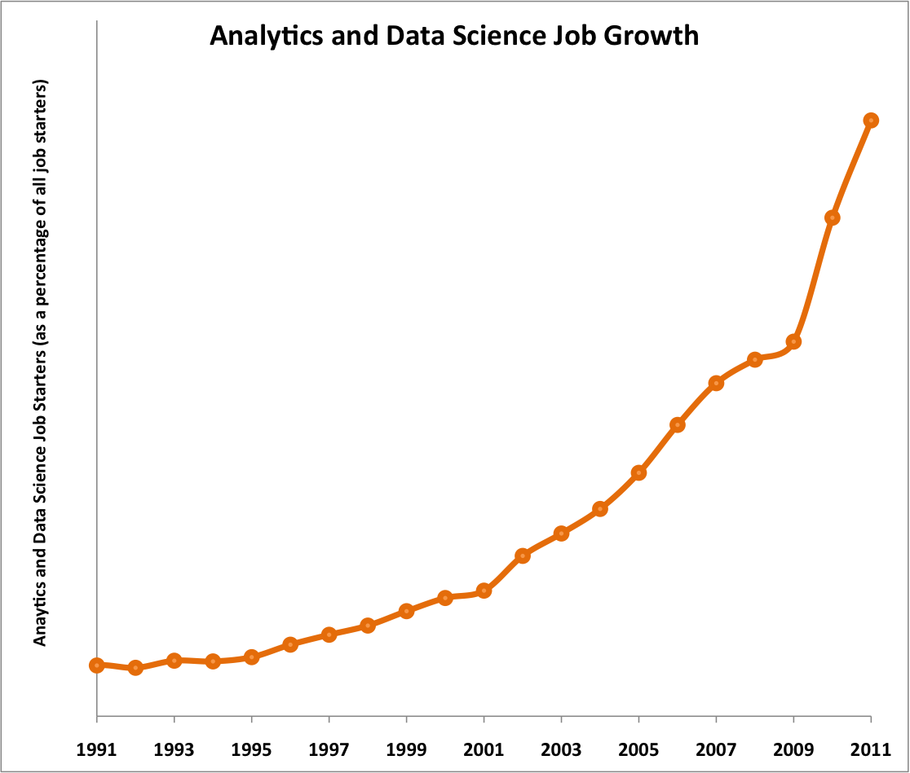
… and the data scientist

Slide 19
@mrogati

